Slide 1
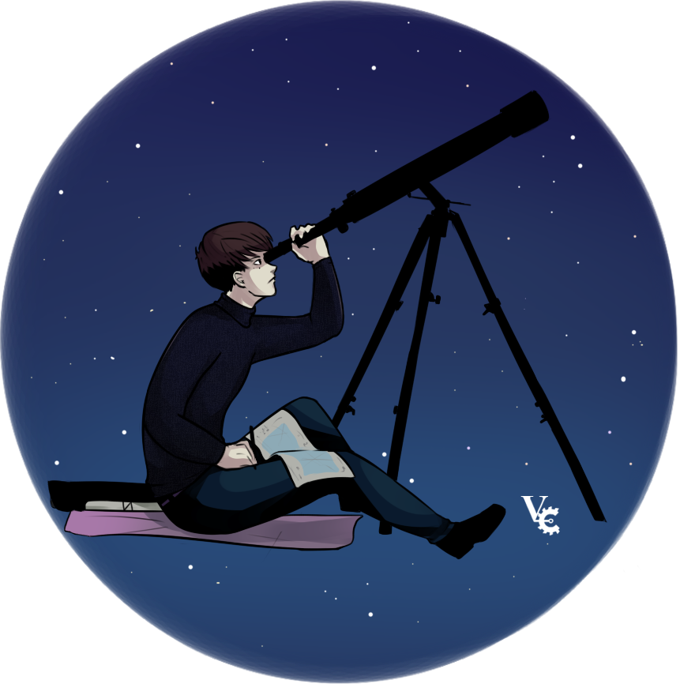
Introduction to astronomy
https://www.youtube.com/watch?v=D8zZZZzppIM&ab_channel=FrankGregorio

Slide 2
Brainstorming
What is astronomy?
What do you know about astronomy?
Do you know any famous astronomer?

Slide 3
What is astronomy?
Astronomy is the science that studies the universe.
It is a really ancient subject: humans have always been fascinated by the night sky.
The first civilizations (Babylonians, Greeks, Egyptians, Mayans…) studied the sky and made the first discoveries.

Slide 4
The history of astronomy
In the paleolithic (35.000 years ago), humans tracked moon phases, and probably used them to make a calendar.
The babylonians (3000 years ago) discovered that lunar eclipses recurred in a repeating cycle.
The greeks (2500 years ago) estimated the size and distance of the moon. They also catalogued stars and named constellations.

Slide 5
The history of astronomy
Astronomy was studied everywhere in the world.
The Persians (1000 years ago) observed the brightest supernova ever recorded and named many stars.
In 1543 Copernicus discovered that the Earth rotates around the sun. Before Copernicus, people thought that the Sun was rotating around the Earth. Aristarchus of Samos had the same idea as Copernicus 2500 years ago, but no one believed him!

Slide 6
The history of astronomy
In 1609 Galileo pointed for the first time a telescope towards the night sky. He observed the moon, and discovered moons on Jupiter.
In 1781 Hershel discovered the planet Uranus. In 1846 Adams discovered the planet Neptune.
In 1920 Edward Hubble discovered that the Milky Way isn’t the whole universe. There are other galaxies, and the universe is expanding.

Slide 7
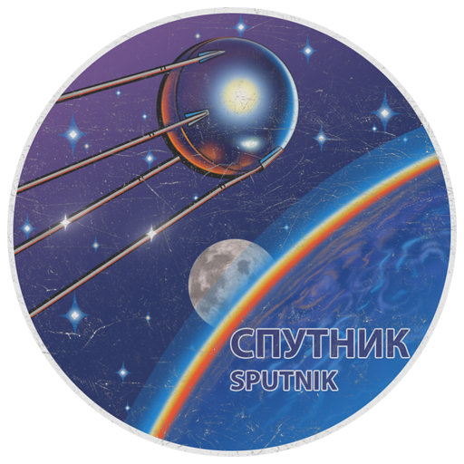
Leaving planet Earth
In 1944 Germans launched the first object in space: the v2 rocket.
In 1957 Russians made the first successful orbital launch, with Sputnik 1 (Satellite 1).
In 1961 Yuri Gagarin (Russian) is the first human in space. With Vostok 1 he completes an orbit around planet Earth in 1 hour and 48 minutes.

Slide 8
Leaving planet Earth
In 1969 Neil Armstrong (American, Apollo 11) is the first human to land on the moon.
From 1970 many different spacecrafts have been sent to explore many different planets and moons.
https://www.youtube.com/watch?v=RU218lEKL6E&ab_channel=InsiderTech

Slide 9
What’s next?
Write on your exercise book what you think humans will do in the next 100 years.
And in the next 200?
And in the next 1000?
In the next 100 years humans will…

Slide 10
Exercises
https://learningapps.org/view28345958
Reading comprehension
Put in order the events

